Slide 1

in-App Search 1
Let’s talk about app

Slide 2

“…They want a quarter-inch hole!”
Content in Apps !!!

Slide 3
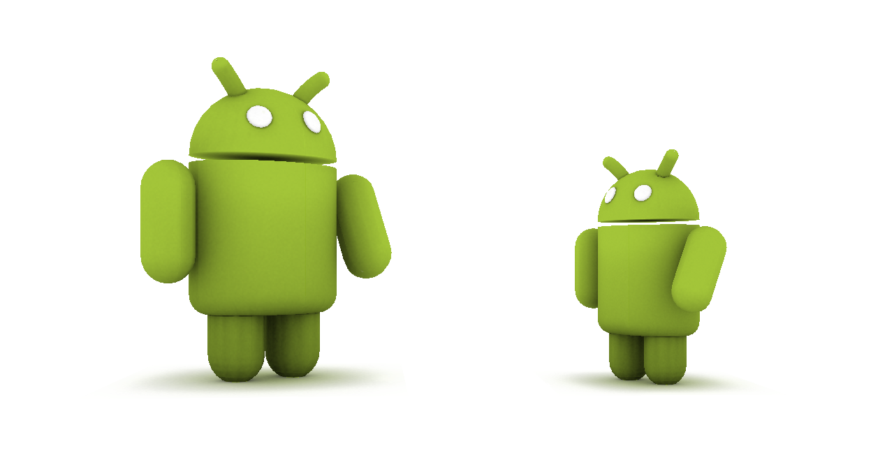
WE know little about apps

Slide 4

Cloud apps

Slide 5

How cloud apps work?
Request
Response
Phone
Servers

Slide 6
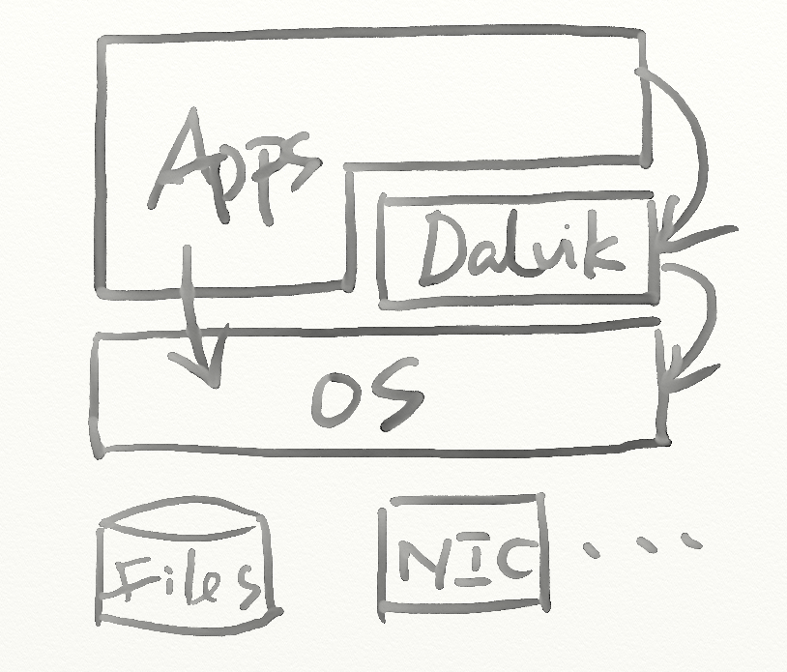
How local apps work?

Slide 7
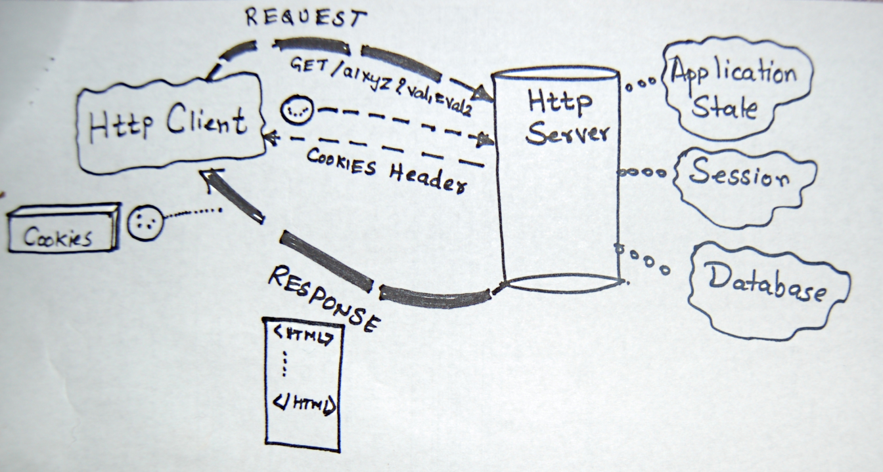
What’s Apps request Is what CUSTOM want to get

Slide 8
CONTENT = API request

Slide 9
CONTENT = HTTP request

Slide 10
Map<Request,Content>?
URLs
Sites
Content

Slide 11
Map<Request,Content>?
URL
http://api.renren.com
Site
http://www.renren.com
Content
SNS
http://search.twitter.com/search.json
https://api.rememberthemilk.com/services
http://www.twitter.com
https://www.rememberthemilk.com
Twitter
Tada list

Slide 12
Penetrated !
Request
Response
Phone
Servers

Slide 13
What we will get?
Accurate feature list for apps
Not self description
Not reviews
Real operations
Web API usage (used to be a part of anti-virus co.)
Developers (advice, protection, copycat…)
Tech trends
Tricks (virus, Ads, hack…)
Software quality

Slide 14
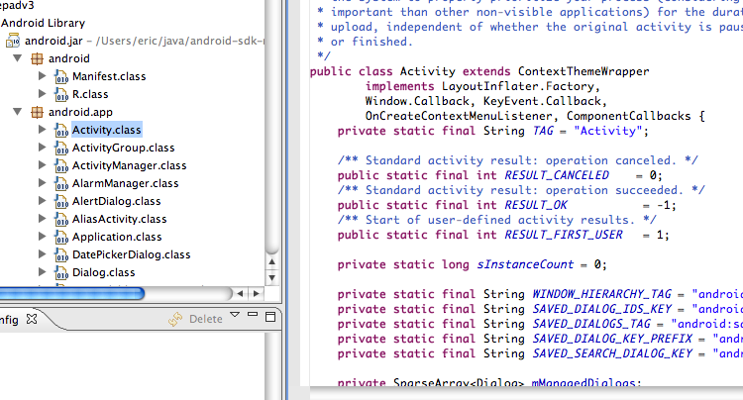
Start diving!

Slide 15
Focus on
ApkReader
URL / Crawling
HTTP request
Binder
API hook
Data flow tagging
API modeling
All above are for lab env.

Slide 16
ApkReader
.dex
.arsc
AndroidManifest.xml
Certification
File last modify time
Native code
Layout (.xml)
Images (.icon .jpg .png)

Slide 17
.dex (ApkReader)
Recognize (header: dex\0)
Decompile
Constant strings

Slide 18
.arsc (ApkReader)
Key-value
Diff between ver.
Similarity between apps (copycat / translation)

Slide 19
AndroidManifest.xml (ApkReader)
Hidden info
Channel
Ad account
Malicious
Exported component
Feature
Attack
Trend
Tech
Business

Slide 20
Certification (ApkReader)
Black/White list
Certificate reputation
<App, Business>
Managed certification
Protection from copycat / stealer

Slide 21
File last modify time (ApkReader)
Dev. activity
Dev. cycle

Slide 22
Native code (ApkReader)
ARM (compatibility)
Find game
Abnormal behavior

Slide 23
Layout / Images (ApkReader)
User interaction
App similarity

Slide 24
Focus on
ApkReader
URL / Crawling
HTTP request
Binder
API hook
Data flow tagging
API modeling
All above are for lab env.

Slide 25
URL / Crawling
Decompile .dex (apktool, dex2jar)
Crawl 2-3 depths for each domain
Find out feature claims (Traditional field for web search engine)
Editors

Slide 26
HTTP request
Tcpdump (even https)
Sandbox (Droidbox)
Compare field names, content with keywords

Slide 27
Binder
Wiretap ( data = mmap(…) )
API hook
Intent
Intent fuzzer
Intent sniffer

Slide 28
API hook
Detection: strace, dexdep…
Action: Source code (Not even a real hook)

Slide 29
Data flow tagging
Tag data in memory
William Enck, Peter Gilbert, Byung-Gon Chun. TaintDroid: An Information-Flow Tracking System for Realtime Privacy Monitoring on Smartphones. 9th USENIX Symposium on Operating Systems Design and Implementation (OSDI’10)

Slide 30
API modeling
Prepare: Decompile dex to source code (apktool)
Cook
<API, feature>
Atom method (BASE64…)
Rebuild apk and monitor critical API invokation
API invoke speed and hotpoint (Software quality)
Monkey (Software quality)

Slide 31
Summary
Static analyze
Dex2jar / apktool /dexdump…
Apk reader
API modeling
Dynamic analyze
Droidbox
Tcpdump
Binder monitor
Api hook
Automatic testing env.
User’s interaction (hard)

Slide 32
Milestones
URL extractor & 2 depths crawling (10-15) Binder monitor (11-1)
Automatic testing env. + Tcpdump (11-1)
Datastore (11-15)
Sandbox env. (11-15)
Apk signature database (12-1)

Slide 33

Questions?
Next

Slide 34
in-App Search 2
Toward content directly

